Slide 1
Hackathon 2016
“SparkING”

Slide 2
Practical information
Start: 22 March, 14:00 (installation until 15:30)
End: 23 March, 16:00 (+ party afterwards)
Location: Heineken Music Hall
Registration on site with personal barcode
Wifi: ING WiFi, ING@2016
More info soon on the website: https://24hcoding.com/

Slide 3
The SparkING Team
Name | Role
Bas Geerdink | Dev, captain
Ger van Rossum | Dev, back-end
Hoda Alemi Neissi | Dev, back-end
Khaled Tokhi | Dev, tbd
Jaap de Koning | Dev, front-end
Niek van de Pas | Dev, API

Slide 4
The Product
Idea: “A realtime API for giving customers a relevant personal homepage and app, based on preferences and historical data”
Short description: “We want to rebuild the API to MING, the mobile app, and external websites, and base the marketing information on realtime feeds, for example with actual clickdata. Data should be personalized based on business rules and AI technology.”

Slide 5
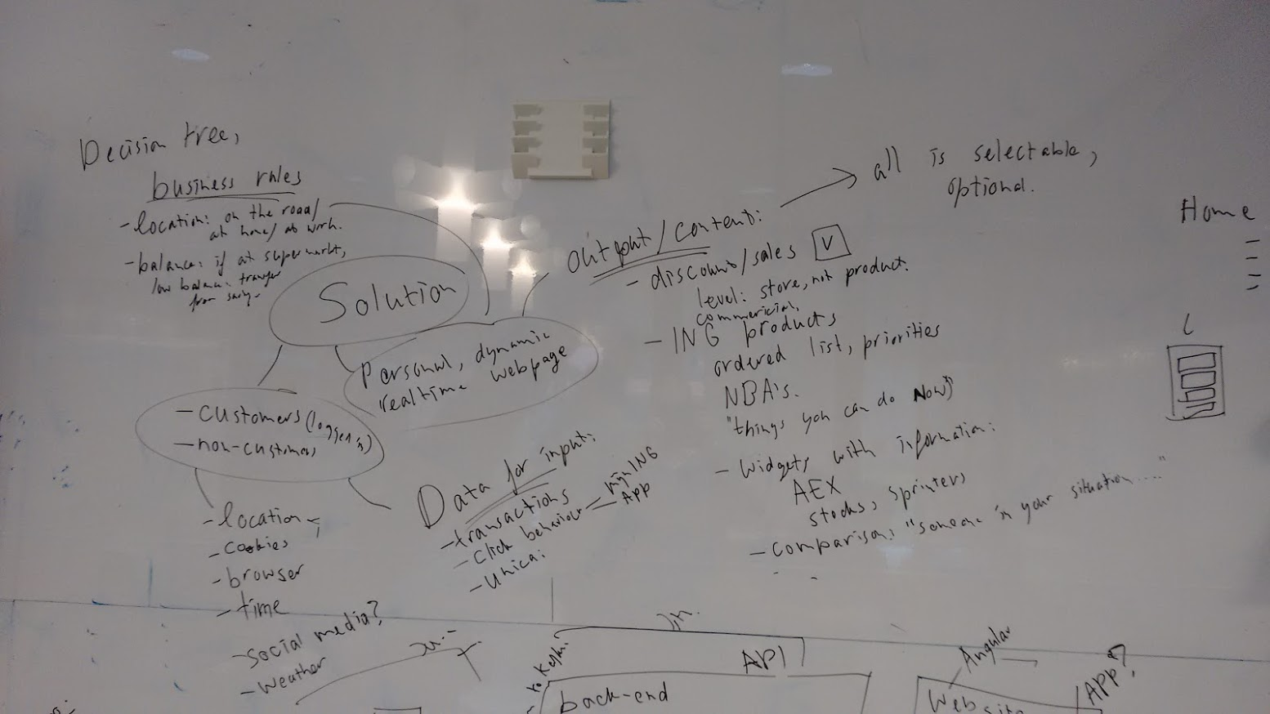
Design

Slide 6
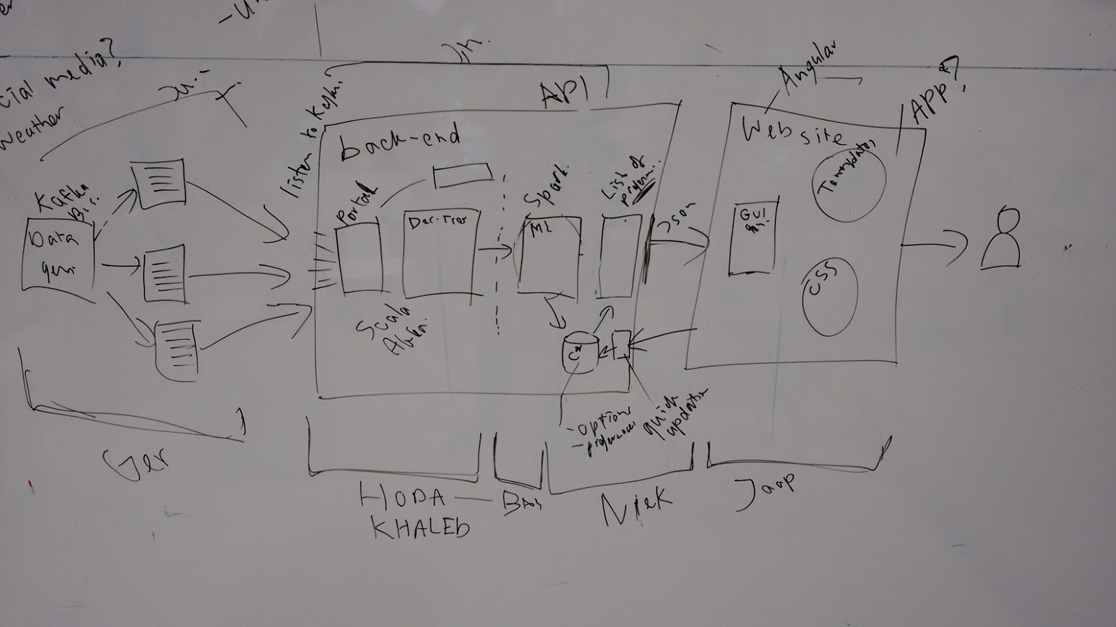
Architecture

Slide 7
Patterns and practices
REST
Reactive manifesto
Lambda Architecture

Slide 8
Tooling
We run the solution on a Linux virtual server, hosted on the PC of Bas
Version control: Github
Backlog: Waffle.io
Chat: Gitter
IDE: IntelliJ 15

Slide 9
Way of working
Scrum, with stand-ups every 2 hours
Everybody works on his/her own part of the solution, to keep interference in each other’s code to a minimum
Push and pull directly to Github, branching and merging only if needed
We start with a “Hello world” use case (minimum viable product), in which a ultra simple data stream is pushed through all the technology components and made visible on the screen
From there, each of us picks up user stories that extend the solution, e.g. more data, a better learning algorithm, a nicer screen, better business rules, etc.
Stuff we need: white boards, wall to hang things up → assume all this is available at the HMH
Strict diet: beer, Red Bull, wodka, coffee, pizza
No sleep allowed ☺

Slide 10
Actionlist
Everybody:
get a Github, Gitter and Waffle account
Prepare a developer laptop with the right tools: IntelliJ, Git, sbt, optional Cassandra/Kafka/Spark
Ger:
Prepare Kafka bus with data generation software
Prepare Cassandra intallation
Bas:
Create repository in Github
Create Waffle board
Fill the backlog with initial user stories
Create virtual server for solution, make it available though the internet
Create skeleton project?
Michel:
Produce a test data file from Unica

